Slide 1


Jim Antonisse, WiSC/NGA-TAEB
Supporting Mirsada Beganovic, NGA/TAEB
28 October 2025
Some comments on Task 7
– Uncertainty/Confidence
The 133rd OGC Member Meeting/Geopose SWG, Boulder, Colorado USA
Meeting Host
Meeting Sponsor

Slide 2


NGA Interest in GeoPose Uncertainty/Confidence
Goal < propose a Standard way to express uncertainty/confidence in GeoPose
National Geospatial-Intelligence Agency (NGA)
NGA’s Mission:
“Know the World, Show the Way…from Seabed to Space”
Knowing the world means
    Acquiring what is not yet known
    Understanding how precise our knowledge is
    And knowing how well we know
Views and opinions expressed here are my own
and do not necessarily represent official views of the NGA
-- Jim.
Notes:
This includes many and diverse applications, e.g., defense, disaster relief, support to first responders…
And requires many and diverse services, e.g., Mapping, Safety of Navigation, Positioning Navigation and Timing (PNT)…

Slide 3
Agenda
Status: Apps seldom expose uncertainty
Goal: Syntactically share levels of confidence
Approach: Recover Previous Work
Progress: Some possible solutions found
Next: Socialize the question, recruit the answer

Slide 4
Status: Apps seldom expose uncertainty

Slide 5
OGC GeoPose SWG: v.2 Work Package item #7
1 | Components
2 | Separate CM and Encodings
3 | Extension Components
4 | CRS Definition in GeoPose
5 | Time Coordinate
6 | New Encodings
7 | Uncertainty
8 | Metaverse Standards Forum (MSF) Prototype Support
We desire a way to describe levels of accuracy – based on the foundations of probability - for the elements of GeoPose
Application is intended to be across the 7 DoF of a GeoPose record
  These may sometimes be assumed independent
    Allowing standard probability intervals to be used to express confidence. E.g, “Linear Error 90” - 90% prob X is between .4 and .6
  But the 7 DoF might be co-dependent
    Requiring either some kind os covariance statistics to be expressed, or some kind of “representation trick” to be used
    E.g, “Circular Error 90” - it is 90% certain that (X,Y) is between .4 and .6
NOTE – this presentation is taking the categorical uncertainty of the object whose pose is being described to be out of scope of this investigation
Current focus
Metadata?
Notes:
…out of scope of this investigation, and perhaps of GeoPose standardization in general
Google: would data markups that indicate the probability bounds of an observation be considered data of metadata?
Data markups that indicate the probability bounds of an observation would be considered metadata. While it is a type of data itself, its primary function is to describe and provide context for the core data it is associated with.
Here is a breakdown of why probability bounds are classified as metadata:
Function
Data is content, metadata is context. The core "data" is the observed value itself, such as a sensor reading or a measured variable. The probability bounds are not the observation but rather a description of its reliability or uncertainty.
It enables understanding. Metadata, like probability bounds, provides crucial information that helps users understand and interpret the primary data. Knowing the bounds helps a user determine the confidence level and potential error in the observation.
Analogy: A book in a library
The book is the data. The actual text, illustrations, and content inside the book are the primary data.
The catalog card is the metadata. The card that describes the book's title, author, and genre is the metadata. It doesn't tell you the story, but it provides the information needed to find, understand, and use the book.
Probability bounds are a note on the catalog card. A markup indicating the probability bounds would be like a note on the catalog card saying, "This book's facts are 95% certain." It describes the reliability of the core content without being the content itself.
Example: A sensor reading
Imagine a temperature sensor in a climate-controlled room that records a reading of 21∘C
The data: The core observation is the value 21∘C
The metadata: Markups indicate that, based on the sensor's calibration and recent performance, the observation is 21±0.5∘C
with 99% probability. This range and probability are metadata. They describe the measurement itself, providing essential context for any analysis of the temperature data.

Slide 6
Goal: Syntactically share levels of confidence
.

Slide 7
Would like a Standard way to express uncertainty/confidence in GeoPose
… provide a way to share levels of confidence in combining evidence in distributed analytics
What is the impact of GeoPose’s lack of expressions for confidence/certainty?
  … across what characteristics that we care about?
FAIR =
  Findable
  Accessible
  Interoperable
  ReUsable
  … Fairness?
Trustworthy AI (NIST, et al) =
  Valid and reliable
  Safe
  Secure and resilient
  Accountable and transparent
  Explainable and interpretable
  Privacy-enhanced
  Fair, with harmful bias managed
Notes:
GeoPose Entered as an Emerging Standard for NGA/NSG/ASG Community
But
GeoPose does not include any way to express certainty/confidence of geopose attributes
Xyz (LatLonElev)
ptr
T
(Note – there is currently an effort also, from an AI perspective, to lock down NGA’s ways of exchanging Uncertainty/Confidence measures associates with location, orientation, and timing in the new AI systems)

Slide 8
Current focus: Syntax/Language for exchanging vs computing Uncertainty
Marr's three levels of analysis
In his 1982 book Vision, David Marr argued that to fully comprehend an information-processing system, you must analyze it at three distinct, complementary levels.
Computational level: What and Why
  Question: What is the goal of the computation, and why is it the appropriate way to solve the problem?
  Focus: This level defines the function of the system, focusing on the logic and purpose of the process, independent of how it is physically carried out. For example, a computational analysis of a cash register identifies its purpose as performing addition and keeping financial records.
Algorithmic/Representational level: How
  Question: How can the computational theory be implemented? What representations are used for the input and output, and what is the algorithm for the transformation?
  Focus: This level details the specific methods and procedures used to solve the problem. Using the cash register analogy, this could involve representing numbers using the decimal system and using a specific set of rules for addition, like adding the least significant digits first.
Implementational level: Physical Realization
  Question: How is the algorithm physically realized?
  Focus: This level examines the hardware or physical substrate that carries out the computation. For a cash register, this could be the mechanical gears of an old machine or the electronic circuitry of a modern one.
INTEROPERABILITY
Notes:
David Marr's "three levels of analysis" offer a framework for understanding complex information-processing systems, such as the brain
. The philosopher Ronald McClamrock reviewed and critiqued this framework in a 1991 paper, highlighting both its promise and its shortcomings.
Alternative three-level models in cognitive science
Other cognitive scientists proposed three-level frameworks that were contemporaneous with Marr's and explored similar ideas using different terminology.
Pylyshyn's semantic, syntactic, and physical levels: Philosopher and cognitive scientist Zenon Pylyshyn's framework distinguished three levels of organization for information-processing systems, drawing parallels to Marr's approach.
Semantic (Computational): The knowledge level, focusing on the meaning and function of the information being processed.
Syntactic (Algorithmic): The symbolic level, concerned with the specific rules and representations used to process information.
Physical (Implementational): The physical or biological level, dealing with the hardware that carries out the computation.
Craik and Lockhart's levels of processing: Psychologists Fergus Craik and Robert Lockhart proposed that memory is not defined by discrete storage locations (like short-term or long-term memory), but rather by the "depth" of mental processing. Information that is more deeply processed is more likely to be remembered. The three levels they identified are:
Structural: Shallow processing based on the physical appearance of a word or image.
Phonetic: Deeper processing involving the sound of a word.
Semantic: The deepest processing, focusing on the meaning of a word.
Daniel Dennett's three "stances"
Philosopher Daniel Dennett proposed a three-level framework, or "stances," for predicting and explaining the behavior of systems, which relates to the analysis of complex cognitive systems.
Physical stance: Explains a system's behavior based on its physical makeup and the laws of physics. It is a precise but often impractical method for complex systems.
Design stance: Explains a system's behavior based on how it was designed to function. It ignores the physical details and assumes the system will behave as intended.
Intentional stance: Explains a system's behavior by treating it as a rational agent with beliefs and desires. This is a common method for understanding human and animal behavior.

Slide 9
Approach: Recover Previous Work

Slide 10
Lean on Previous Work
Use existing Standard(s) as available and appropriate (and update as necessary)
Propel into OGC/GeoPose Standards regime
  Previous work on uncertainty/confidence from statistics.
  Applications to image analysis goes back many decades
    Prev experience – Bayesian conditional probabilities (Bayes Nets) for object detection from satellite imagery
      Foundation = probability that a pixel is evidence for a vehicle
      Vehicles in part of an image? Integrate over that part of the image
  Previously considered and/or adopted by Standards Agencies
Will do a quick review and make a recommendation

Slide 11
Progress: Some possible solutions found

Slide 12
Review of earlier approaches
“Previously considered and/or adopted by Standards Agencies”
Ay! Big job. Called on GenAI (ChatGPT5) to start things off
The Open Geospatial Consortium’s (OGC’s) UncertML initiative (circa 2009)
OGC Abstract Specification Topic 20: Observations, measurements and samples (2023)
IETF RFC 7459 “Representation of Uncertainty and Confidence in the Presence Information Data Format Location Object (PIDF-LO)” (2015)
ISO 19157-1:2023 “Geographic information — Data quality Part 1: General requirements” and especially its Part 3: “Data quality measures register”
NGA Standardization Document “3D GEOINT Standard (2023-01-04)”,
NGA Standardization Document“Accuracy and Predicted Accuracy in the NSG: Predictive Statistics (2021-04-23)”,
NGA Standardization Document“Community Sensor Model Generic Photoblock (2021-06-07)”,
GEOINT Working Group (GWG) Motion Imagery Standards Board (MISB) “Motion Imagery Standards Profile-2023.2” and associated MISB Standards
Notes:
Characterizing what code needs to be added to bring to conformance with GeoPose
Estimating what kind of positive and negative impact the integration would have

Slide 13
ChatGPT Analysis Summary (?) of GeoPose Uncert/Confidence options
We seek a way of associating effective measures of uncertainty or confidence, based on probability, with geolocation and orientation of objects or features in time as expressed in the Open Geospatial Consortium (OGC) GeoPose Standard. There are a number of computational frameworks within which GeoPose information may be expressed, including <snip, snip>.
Please describe what formalism each uses …
Please also describe how they would syntactically express the probability-of-correctness …

Slide 14
ChatGPT GeoPose Uncert/Confidence options in different system contexts
Framework | Pose fields | Time | Uncertainty primitive | Cross-axis dependence | Typical scalar roll-ups | Canonical carriage
OGC O&M / ISO 19156 | GML/SWE position; SWE vector for roll/pitch/yaw | phenomenonTime / resultTime | Quality results + UncertML / SWE arrays | Yes (full covariance via UncertML/SWE) | CE90/LE90/RMSE | XML/GML/SWE. Open Geospatial Consortium+1
UncertML | (External) | (External) | Distributions, statistics, realizations | Yes (multivariate) | Any (derived) | XML/JSON fragments. OGC Portal+1
RFC 7459 / PIDF-LO | Geodetic shapes (point/circle/ellipse) | timestamp | Radius/ellipse + confidence | Not general; shape-only | Radius @ confidence | XML (PIDF-LO). IETF Datatracker+1
ISO 19157-1/-3 | (External) | (External) | Registered measures (e.g., CE90, covariance) | Yes (measure for covariance matrix) | CE90/LE90, RMSE | XML/JSON metadata. Itel Standards+1
ISO/IEC 5259 | (External) | (External) | Data-quality governance & documentation | Conceptual (document your model) | Any (declared) | JSON/records. ISO
NGA 3DGS (2023-01-04) | 3D nodes/transforms (CRS aware) | Content timestamps | Product accuracy fields; attach 19157/CE/LE | Optional covariance sidecars | CE90/LE90 | Sidecar JSON/XML. SDSFIE
NGA Predictive Statistics | (External) | (External) | A-priori covariance ⇒ CE/LE/SE | Yes (input covariance) | CE90/LE90 | Math/metadata refs. ASPRS+1
CSM / Generic Photoblock | EO: X,Y,Z,Ω,Φ,Κ or quat per image | Image/time tags | EO covariance (per image/block) | Yes (full block covariances) | CE/LE (derived) | JSON/XML photoblocks. MDPI+1
MISB MISP-2023.2 + ST 0601/1107 | KLV: sensor lat/lon/alt, heading/pitch/roll | Precision timestamp | ST 1107 CE/LE; limited native covariance | No (unless vendor tags) | CE90/LE90 | KLV in MPEG-TS/RTP. Wikimedia Commons+2ImpleoTV+2

Slide 15
Example: Motion Imagery Standards Board
GWG/MISB – MISP-2023.2 + MISB ST 0601 / ST 1107 (KLV)
Pose & time. In Full-Motion-Video, KLV metadata carries platform heading/pitch/roll, sensor lat/lon/alt, timestamps, etc., via ST 0601. Metric geopositioning/interpretability live in ST 1107/1108; MISP 2023.x profiles which tags are required. OGC Portal+4Wikimedia Commons+4ImpleoTV+4
Uncertainty. ST 1107 defines geolocation accuracy fields (e.g., CE90/LE90). KLV does not natively ship full covariance, but you can add vendor tags or map to external quality docs.
Sample (friendly JSON mirror of KLV content):
{ "klv0601": { "precisionTimeStamp": "2025-10-27T20:05:00Z", "sensorLat": 39.739200, "sensorLon": -104.990300, "sensorTrueAlt_m": 1600.0, "platformHeading_deg": 92.5, "platformPitch_deg": -1.0, "platformRoll_deg": 0.2 }, "st1107": { "CE90_m": 8.1, "LE90_m": 12.0, "confidence": 0.90 } }

Slide 16
Example: NGA Standardizations
NGA “Accuracy & Predicted Accuracy in the NSG: Predictive Statistics”
Pose & time. Not a pose container—this document (and related ASPRS work) formalizes predictive (a priori) vs sample (a posteriori) accuracy; converts covariance into scalar metrics like CE90/LE90. ASPRS+2ASPRS+2
Uncertainty. Start from a 2D/3D covariance, compute CE90/LE90/SE (temporal) using chi-square factors; retain the full covariance to preserve dependencies.
Sample (deriving CE90/LE90 from covariance):
# concept only: CE90 ≈ k * sqrt(σx^2 + σy^2) when ρ≈0; general case uses eigenvalues k_ce90 = 2.146 # 90% Rayleigh equivalent; exact factor depends on convention k_le90 = 1.6449 # 90% 1D normal CE90 = k_ce90 * ((cov[0][0] + cov[1][1] - 2*cov[0][1])**0.5) # placeholder LE90 = k_le90 * (cov[2][2]**0.5)

Slide 17
Example: NGA Community Sensor Model
GWG Community Sensor Model (CSM) – Generic Photoblock
Pose & time. CSM & Generic Photoblock serialize exterior orientations (X,Y,Z, Ω,Φ,Κ / or quaternions) per image, plus rigorous sensor models; photogrammetric bundles usually include normal matrices/covariances. MDPI+2USRA Houston+2
Uncertainty. Store full covariance for EO parameters and tie points—this naturally captures cross-axis dependencies.
Sample (Photoblock-like JSON):
{ "images": [{ "id": "img001", "exteriorOrientation": { "X": -104.99, "Y": 39.739, "Z": 1600, "Omega": 0.003, "Phi": -0.017, "Kappa": 1.615, "t": "2025-10-27T20:05:00Z" }, "covariance": { "dimension": 7, "values": [ /* 7x7 EO covariance incl. time drift */ ] } }] }

Slide 18
NGA – core representations
NGA supplies extensive and sophisticated methods for computing errors and interpreting between error models
Core commitments to selected representations:
  Spherical Error Confidence Interval (e.g., SE90)
  Linear (Elevation) Error Confidence Interval (e.g., LE90)
  2D/3D Error CoVariance Matrices/Ellipses
  2D/3D Error CoVariance Matrices/Ellipses
  Linear (Elevation) Error Confidence Interval (e.g., LE90)
  Spherical Error Confidence Interval (e.g., SE90)

Slide 19
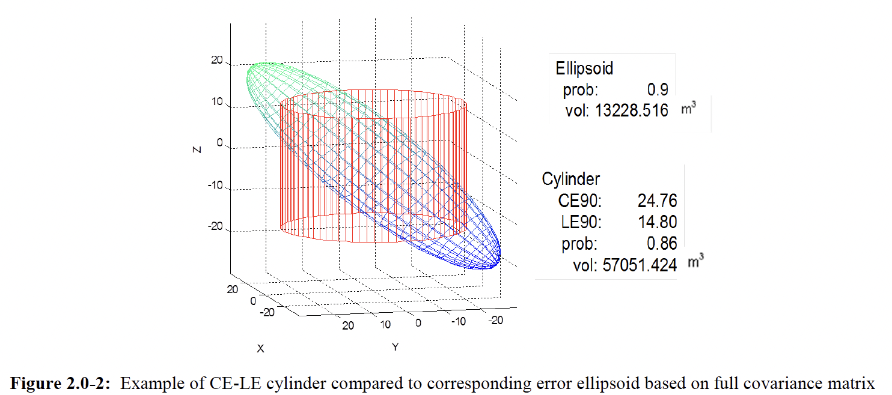
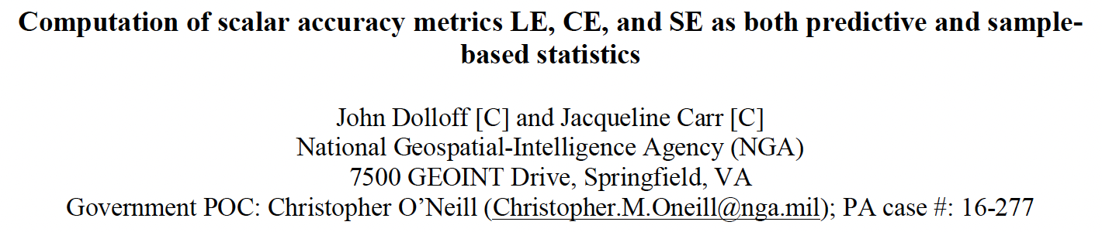
NGA focus has been on Spherical and Linear Errors, CoVariance
Adopt and generalize for GeoPose?

Slide 20
Next: Socialize the question, recruit the answer
.

Slide 21
Socialize GeoPose in the NGA and OGC user communities
OGC: separate Uncertainty/Confidence out from GeoPose as (generic) Metadata?
NGA: Has been solving this problem through Standards for a long time.
  So, mightn’t we adopt the NGA solution?
    Complete/tested/widely used
    (Can everybody access?)
  But, mightn’t we propose that NGA adopt an OGC solution?
    What would be the payoff to NGA? Interoperability?
    So, NEXT: Address the question
    This begs for a Cost/Benefit Analysis so a rational decision can be made.
Why NGA would adopt the OGC solution to Uncertainty vs its own.

Slide 22

THANK YOU
www.ogc.org

Slide 23
Innovation
Community
Standards
120+ Innovation Initiatives
380+ Technical reports
OGC hosted services
GeoCipher
OGC Advice and Capabilities building
550+ Members
60+ Alliance partners
50+ Standards Working Groups
45+ Domain Working Groups
25+ Years of Not for Profit Work
65+ Adopted Standards
300+ products with 1000+ certified implementations
1,700,000+ Operational Data Sets Using OGC Standards
Testbed 19 Demonstration and Outreach |

